Slide 1
Explore Hoboken
By Ryan Clark, Ryan Chin, Andrew Narvaez, Matthew Hullstrung, Roshan Narma

Slide 2
What is Explore Hoboken?
Explore Hoboken is a website that allows users to look for things to do in Hoboken. Whether it be getting something to eat, doing an activity, or finding live entertainment, Explore Hoboken makes it easy.
If you’re a long time resident, visitor, student, or someone just passing through, Explore Hoboken can make sure you’re always busy!

Slide 3
E (Efficiency)
The E we have chosen to focus in on has been Efficiency. Our goal in this project is to minimize the time it takes to find events, and choose between them. This requires a fast search system, and a quick simple way to view all options available. This also includes minimizing errors that would slow down the user. We would also make an intuitive UI that requires very limited learning to understand functionality.

Slide 4
Target Population
Our target population consists of younger generations in Hoboken, who are new to the area. This includes Stevens students, young couples new to Hoboken, or out of town visitors looking to explore the city. We expect these populations to have limited time with classes/work/travel and needing the fast possible option available to them.

Slide 5
Preliminary User Survey Results
We had two main sources of information, the Stevens Institute of Technology yearly reports, and the Stute do polling on campus. The Stute offered information on housing numbers of mostly freshmen being on campus, with upperclassmen being in apartments in a separate ecosystem.
The yearly reports from Stevens gave us information on GPA, common clubs including the ultimate frisbee team, and C2GS(computers and gaming society). It also had where students came from, and a large majority of the student population came from outside of the Hoboken/NYC city area.
Our competitors include Google Maps, Trip Advisor, and Hoboken Girl. We hope to beat these competitors with simplicity, as each of these organizations do more than just search for nearby activities, and will likely clog up the screen and take longer to find.

Slide 6

Persona
Cole Gardella
⦁ Graduated from Newark Charter High school.
⦁ Incoming freshman at Stevens with a 3.9 GPA, Captain of his high school Ultimate Frisbee team, and a huge Slay the Spire (the video-game) nerd.
⦁ Unfamiliar with Hoboken
⦁ Does not have many upperclassmen friends
⦁ Always hears him say: “I don’t know what to do”
Motivation for website is intense schedule and want and figuring out plans faster than other sources.

Slide 7
First Iteration
Our first design was very similar to Google Maps, where the display would show on a map. It would require inputs on type of event, location, and keywords to search for. It would then display an overlay of the map, that would pop up with individual activity results when clicked on.
We measure the speed it takes to search. The user needs to be able to look at multiple options for the topic and make an informed decision based upon the information given.

Slide 8
User Feedback
We talked to 5 Stevens students for our initial feedback study. We received feedback that our initial testing design was cluttered. It was hard to tell the information in an organized manner. We also received feedback about the amount of work required to input a single request. Having to input an area, a type of event, and keywords was more complicated than it should have been. It was also hard to preview options easily, as you had to individually click on the options below to read more about them, instead of them displaying easily all together.

Slide 9
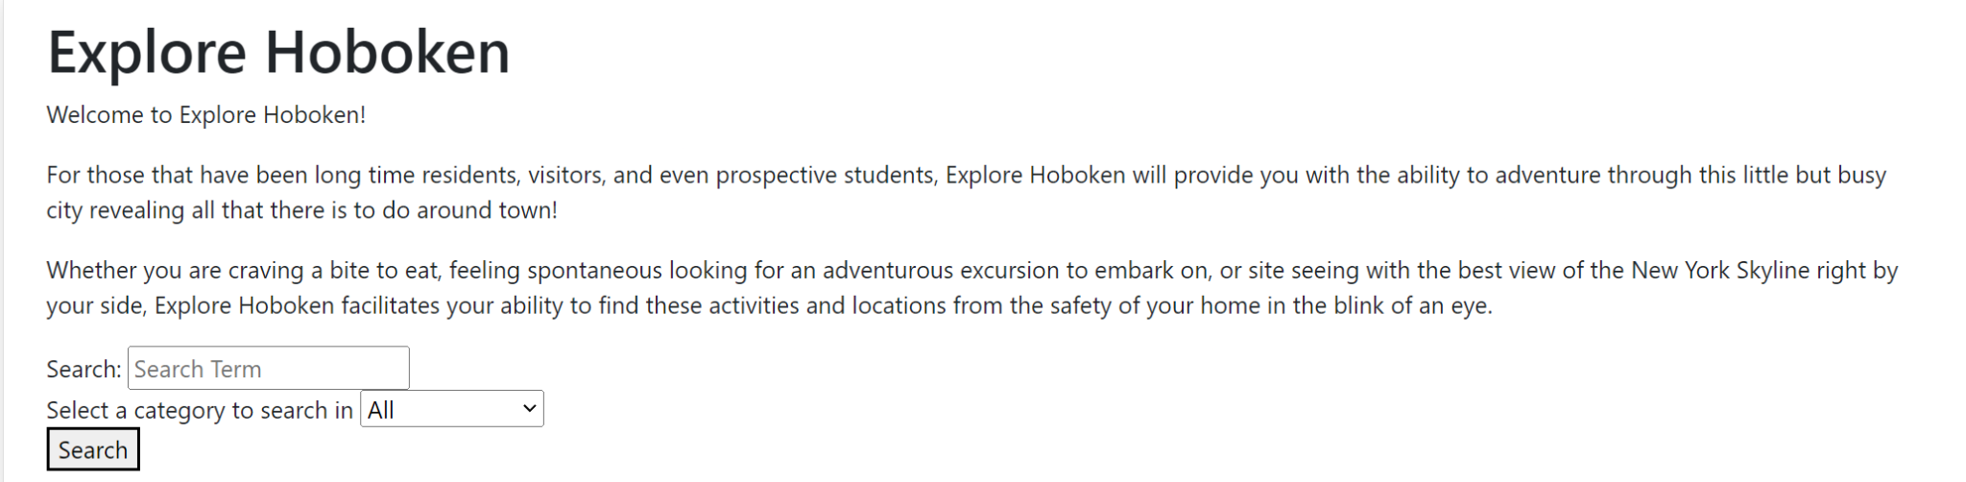
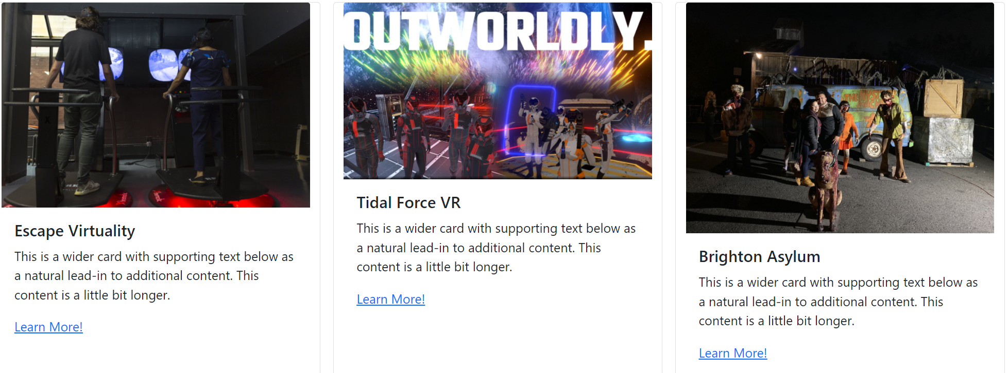
Iterations
Iteration 2
We had 5 members test out this iteration of the website. The main feedback we received was the lack of professional look. We hoped to change this in the upcoming iteration. We also hoped to show a better preview on the cards for the activity, since currently we had a temporary message in place, as our API did not have a summary on the topic in place. Our website was also not interactive and acted like a form submitting, and we hoped to change that in our future iterations.

Slide 10
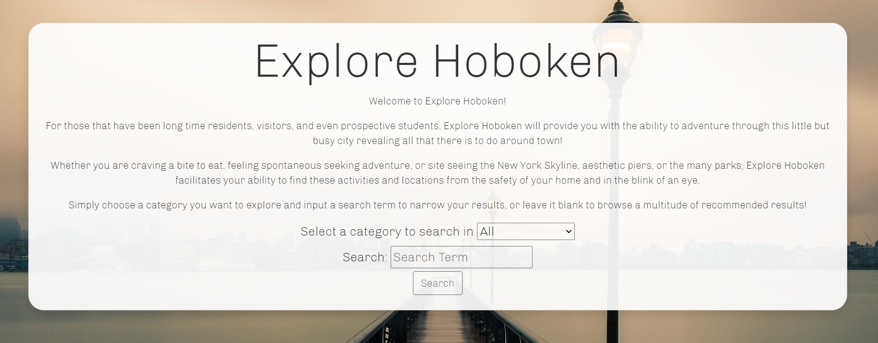
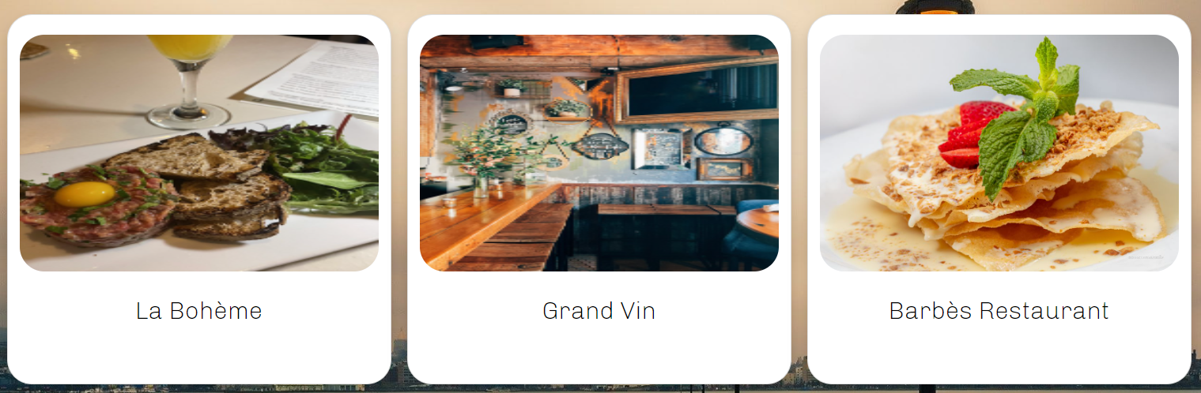
Iterations
Iteration 3
We received much better feedback on this version from our 8 testers. These testers included the 5 that saw the previous version, along with 3 more participants to get both perspectives of new and old perspectives. We decided to make some changes to help give more haptic feedback feel. For example, when hovering over options, they would grow larger. We also made things more centralized to be drawn easier to the eye. We made the website look more professional with backgrounds, rounded edges, and a nicer grid system.

Slide 11
Demo
See README file on the GitHub repository for the YouTube link of a demo of our site!
https://github.com/Andrewnar/Explore_Hoboken

Slide 12
Reviews of Design - PAR
Simplicity review
Accessibility review
Our project has been following the ideas of PAR by using bubbles around each event for grouping. We removed unnecessary information from the screen when searching, only showing images and the titles. We attempted to simplify sections by only displaying important information, to not overwhelm the user.
Our display now properly works on smaller screens like smartphones, and scales appropriately. Our users liked our final changes, and commented mostly on the professional feel and the quick and easy search, simplifying the product down to the important sections without extras.

Slide 13
Heuristic Evaluation
(Kessel)
Simple Dialogue: yes
Speak User’s Language: English Language for Hoboken
Minimize user’s memory: does not store user’s data
Consistency: yes
Feedback: haptic-like feedback with enlarging size when hovered over
Clearly marked exits: home button in top left corner
Shortcuts: Make another search below search results, Bottom right has an arrow to return to the top of the screen
Precise error messages: yes
Prevent errors: simplistic design and drop-down bar to prevent non existent options
Help and documentation: no

Slide 14
Microinteractions
Final data from users
Improvement for Target E(efficiency)
We used microinteractions from as simple as a button to search or to return to the home page, to a drop down bar to choose between options. We had a form to fill out text, and expanding cards triggered by hovering. We also threw errors when the server had problems reaching the request from the client.
We achieved our goal of efficiency by turning our product from 3 inputs including current location, writing out the genre, and keywords to 2 inputs, dropdown bar for topic, and a genre input. We also made it open a much more accessible page to find events faster with cards, instead of trying to display an overlay map of Hoboken/NYC area. This overlay map of Hoboken area required individual clicks on each event to learn their names and picture.

Slide 15
Future Work
Our next steps would be to call another api to gather summaries for facilities, as the Yelp API we used did not include this. We would also hope to get the current location of the user through the browser without needing to require the user to input the current location. This would help us build a sorting algorithm for the user to use including rating, location, closeness to keywords.
We are unlikely to work more on the project after this is completed. Most of us are busy during the summer with summer internships/research.

Slide 16
Active Review
We attempted active reviews by asking individual feedback about certain sections, rather than the project as a whole. This way would get more comments, regardless of the opinion on the overall design, and help pinpoint which areas were struggling the most.
We could have improved on our active reviews by following a suggestion from Parnas of getting questions from our population we polled before creating Explore Hoboken. This way we can go outside of the perspective of an author of the product, and see what is the important values of a potential user of the product.

